Slide 1

Traffic light system with pedestrian light
By maxim speczyk

Slide 2
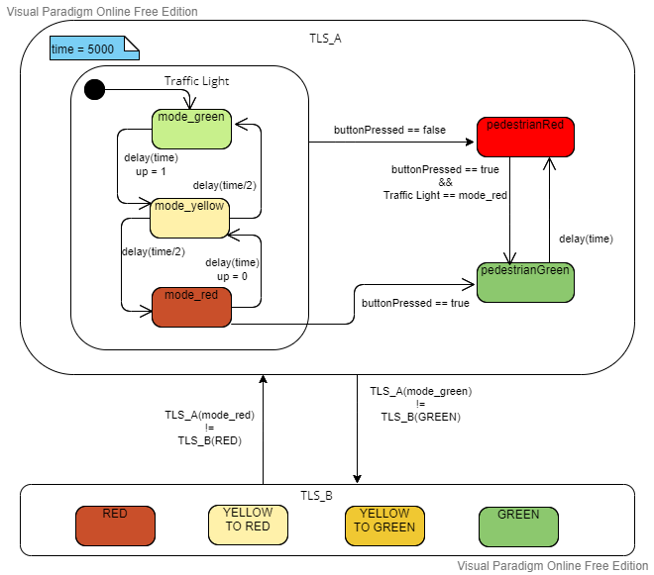
State machine
3 main states
mode_green
mode_yellow
mode_red
2 states for the pedestrian
pedestrianRed when
buttonPressed == false
pedestrianGreen when
buttonPressed == true
mode_red == true

Slide 3
State machine
4 events for the communication
When TLS_A is green TLS_B can not be green
When TLS_A is red TLS_B can not be red
I2C communication
TLS_A master
TLS_B slave

Slide 4
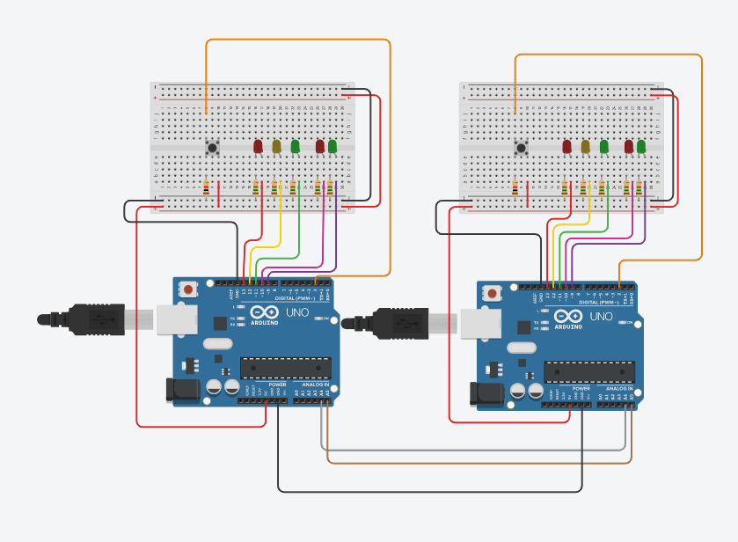
Tinkercad model
TLS_A
TLS_B

Slide 5
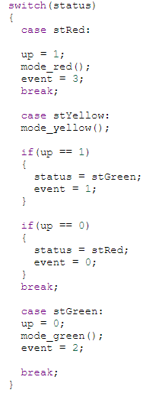
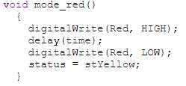
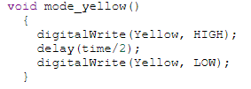
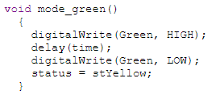
State machine to code Traffic light

Slide 6
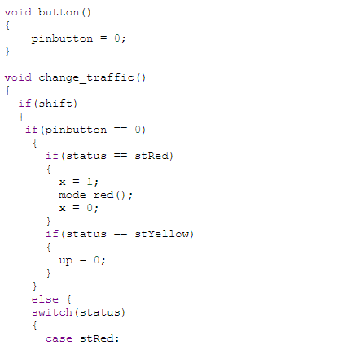
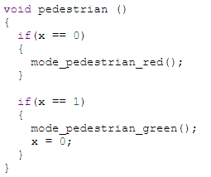
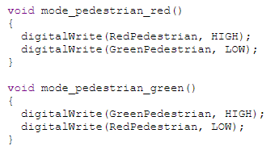
State machine to code pedestrian light
Implemented with an attachInterrupt

Slide 7

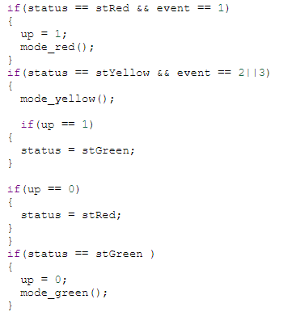
State machine to code communication between to Arduinos
TLS_A
TLS_B
I2C communication
TLS_A master
TLS_B slave
TLS_B depends on the events that TLS_A shares
event 0 = red
event 1 = green
event 2 = yellowToRed
event 3 = yellowToGreen

Slide 8
Thank you for listening
Have a great day

